Slide 1
Figures draft for manuscript
The numbers are provisory

Slide 2
Gamma method

Slide 3
Ewens method

Slide 4
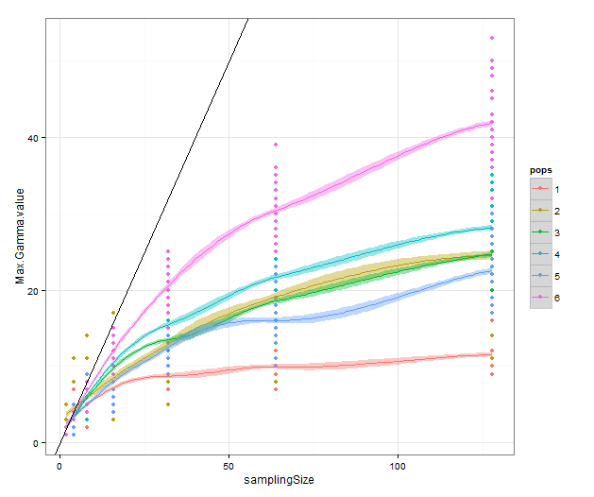
Figure 3a

Slide 5
Figure X2b

Slide 6
New Version!

Slide 7
Distribution of segregating sites in the simulated populations
Theta 2
Theta 10
Theta 20

Slide 8
Distribution of segregating sites in the simulated populations
Theta 2
Theta 10
Theta 20

Slide 9
Theta 2

Slide 10
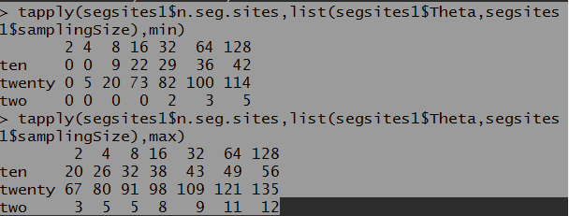

Slide 11
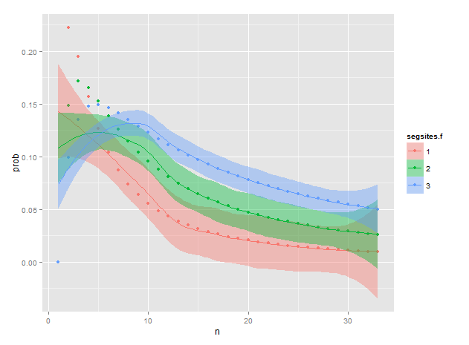
Theta two, n=2

Slide 12
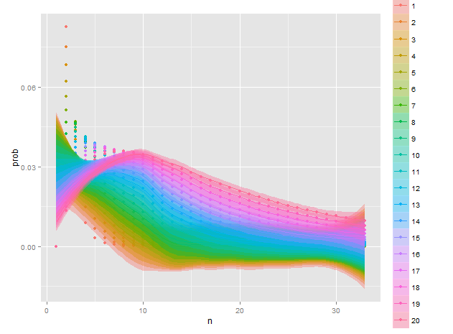
Theta ten, n=2

Slide 13
Maybe supp material??

Slide 14
Figure X1
120
100
80
Sample size (n)
60
40
20
0
1
2
3
4
5
6
0
5
10
15
20
25
30
Minimum number of haplotypes observed

